Slide 1

Mocanu Alexandru
Network Security
University of Bucharest
Security and Applied Logics
Downgrade Attacks on TLS
and how are they prevented now

Slide 2

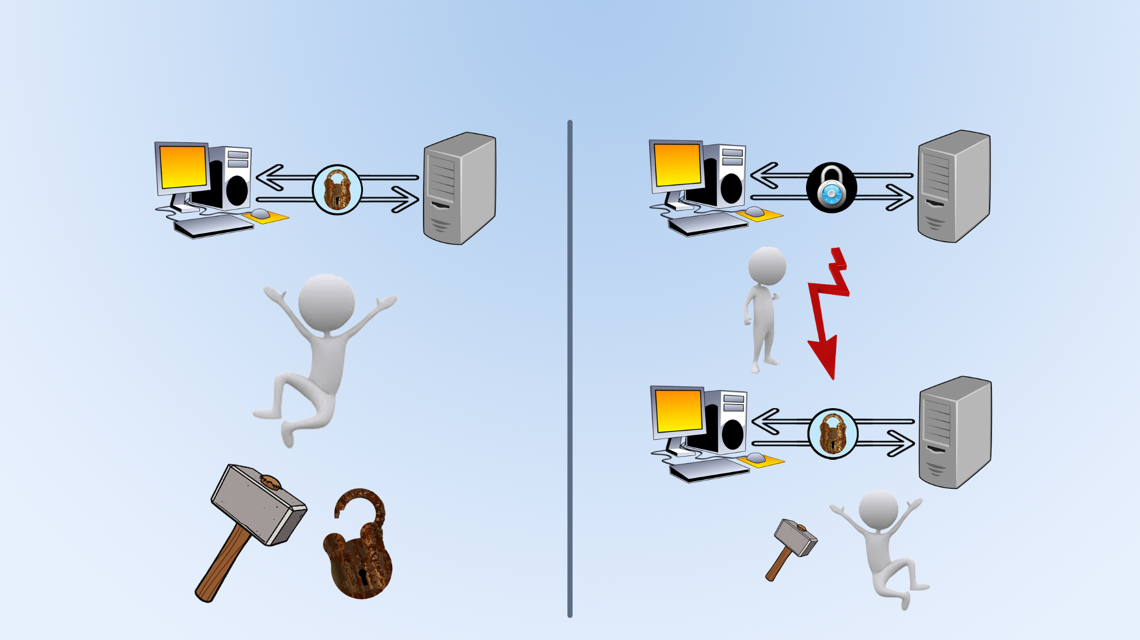
Downgrade Attacks
old version
new version
downgrade
attack

Slide 3
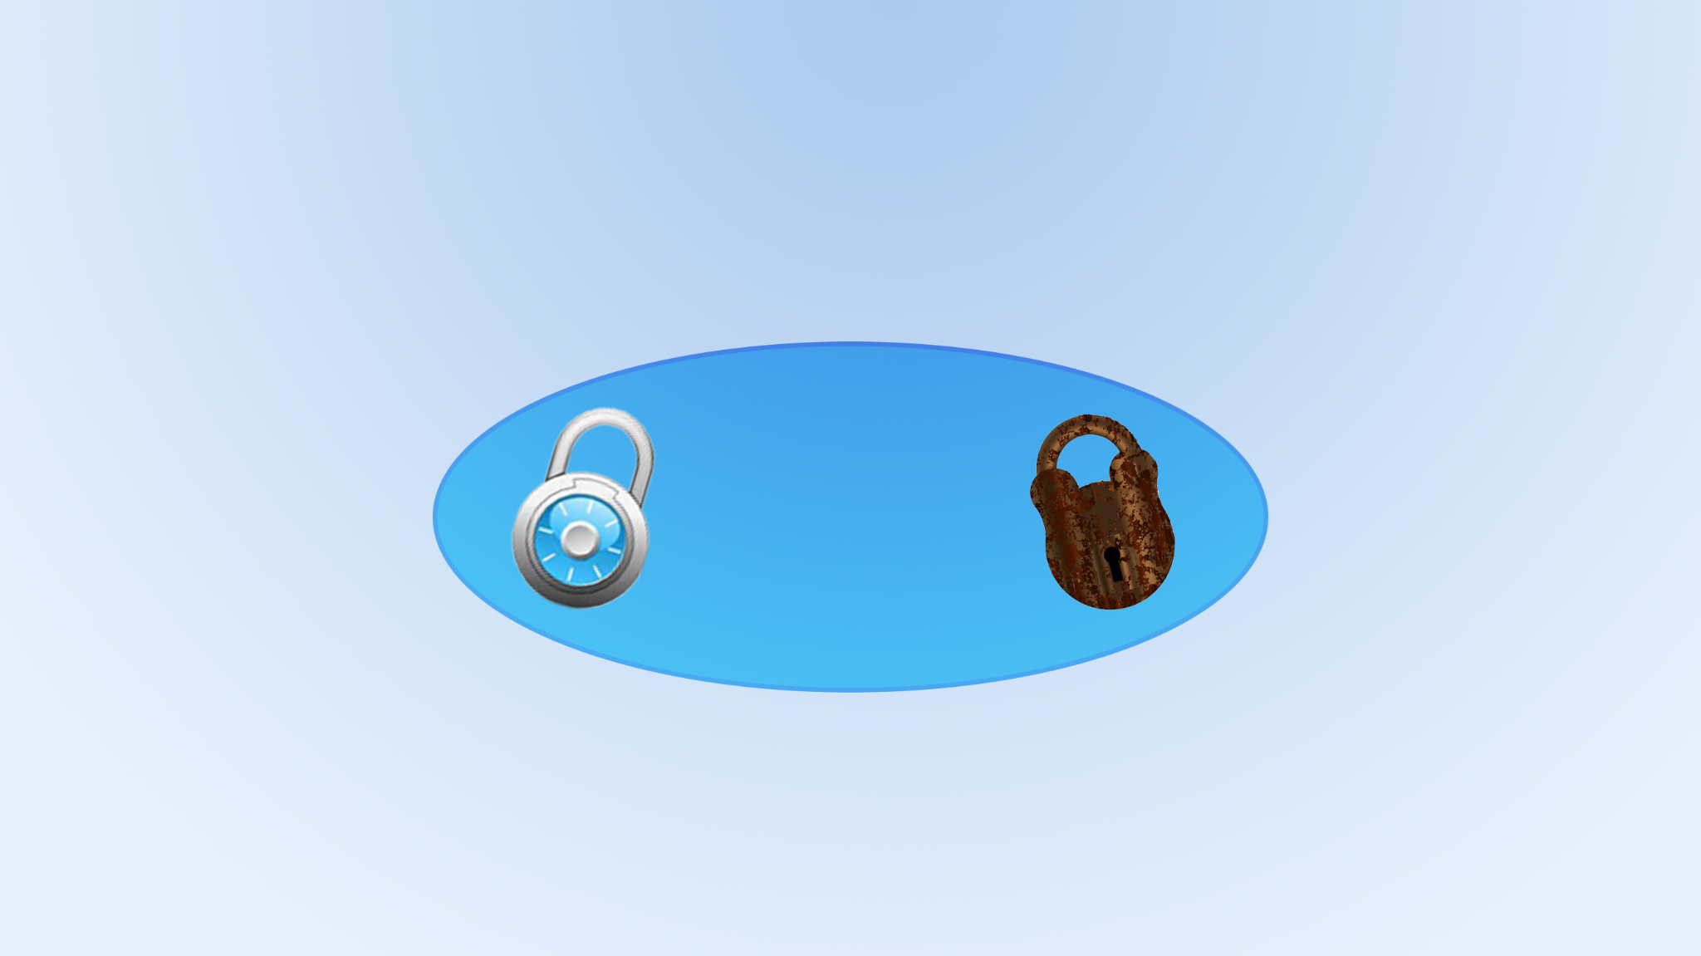
Downgrade Attacks
New
Version
Backwards Compatibility

Slide 4
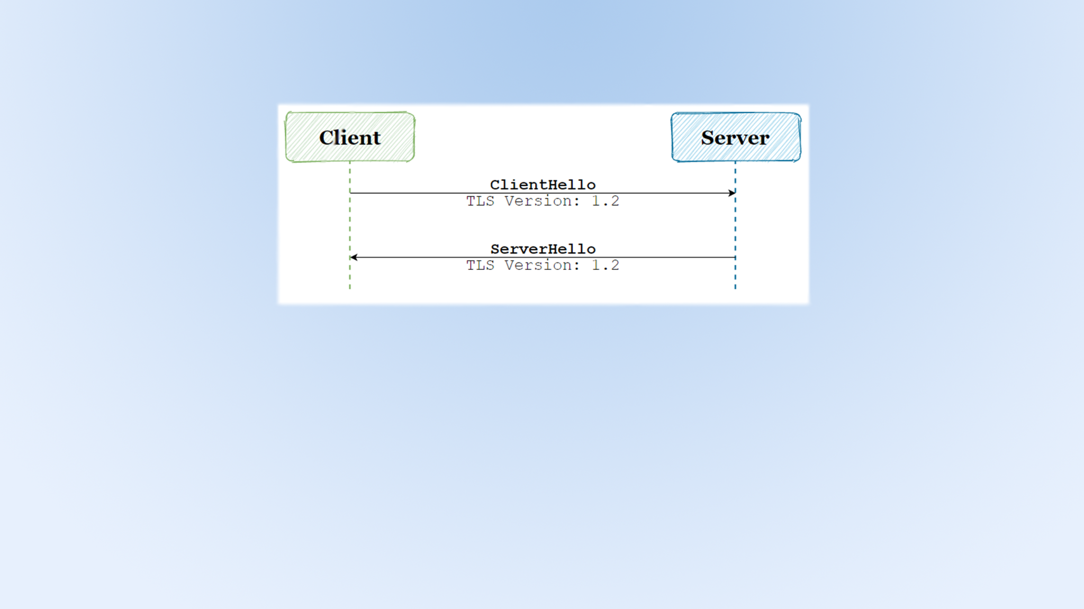
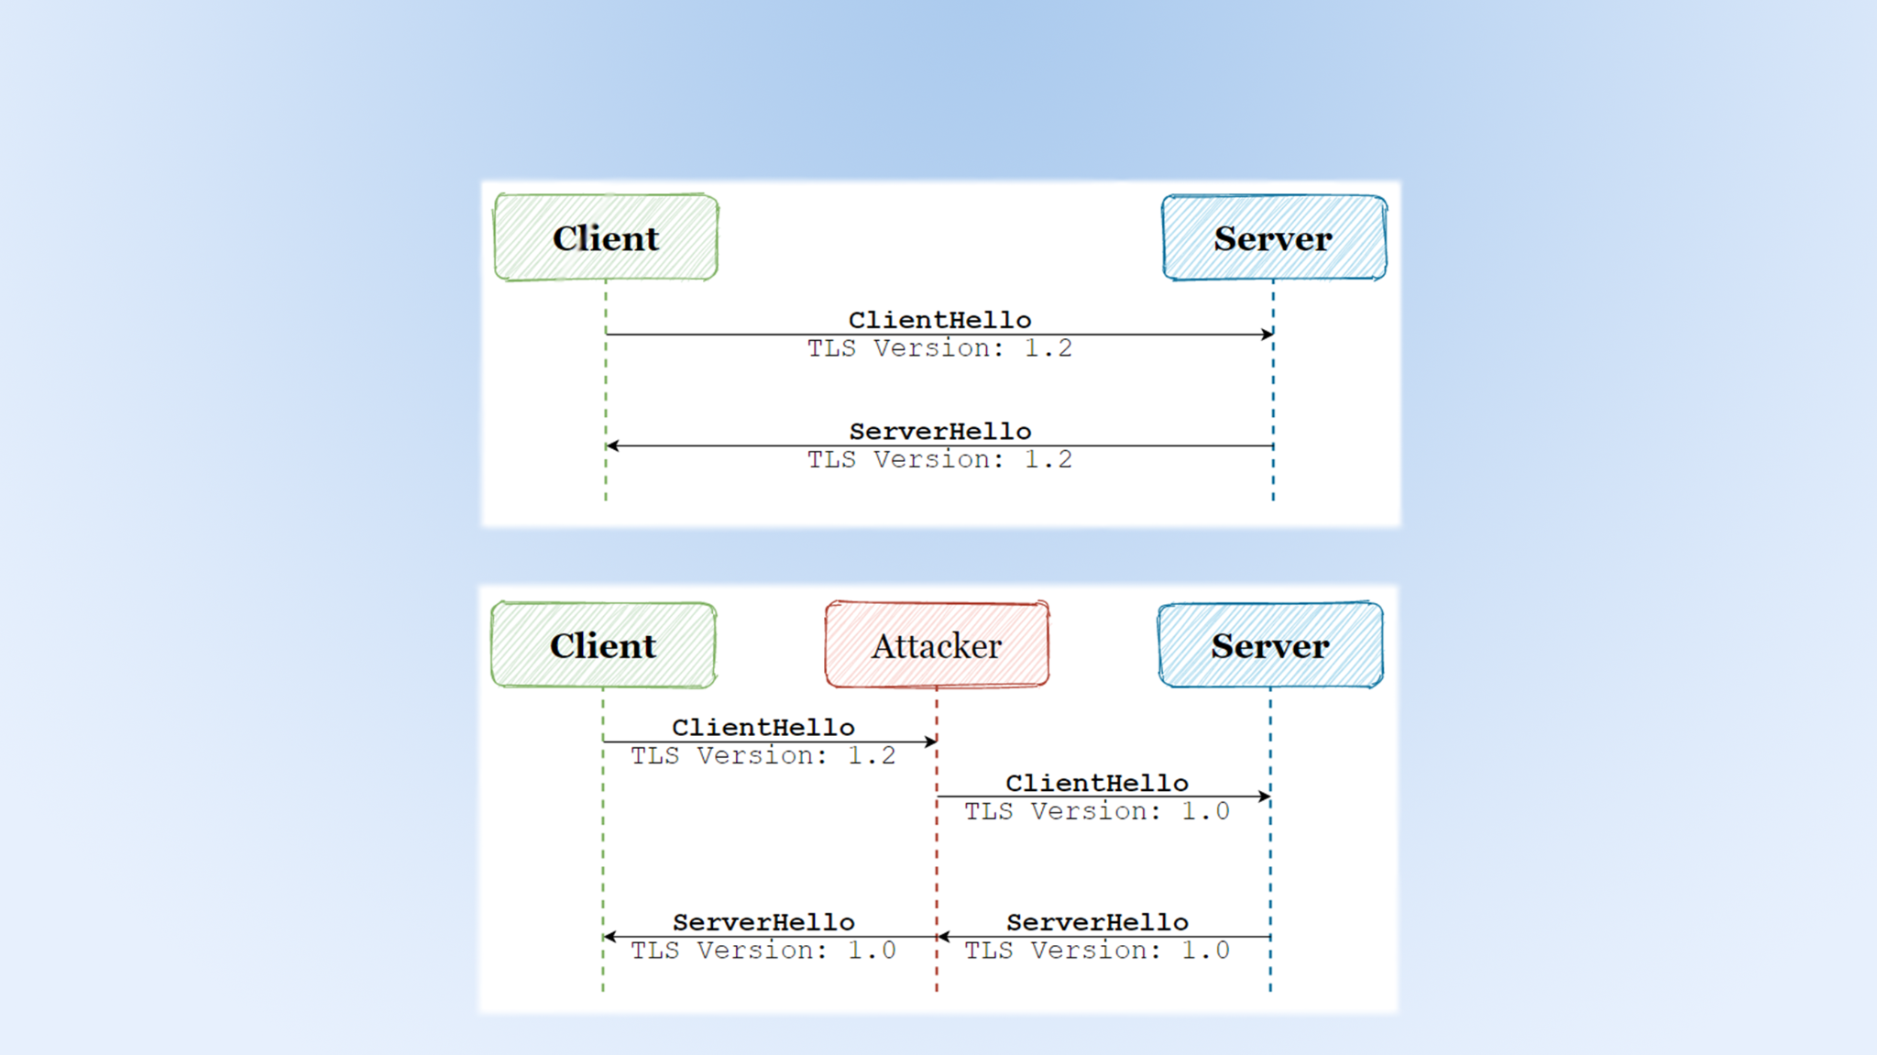
A simple attack

Slide 5
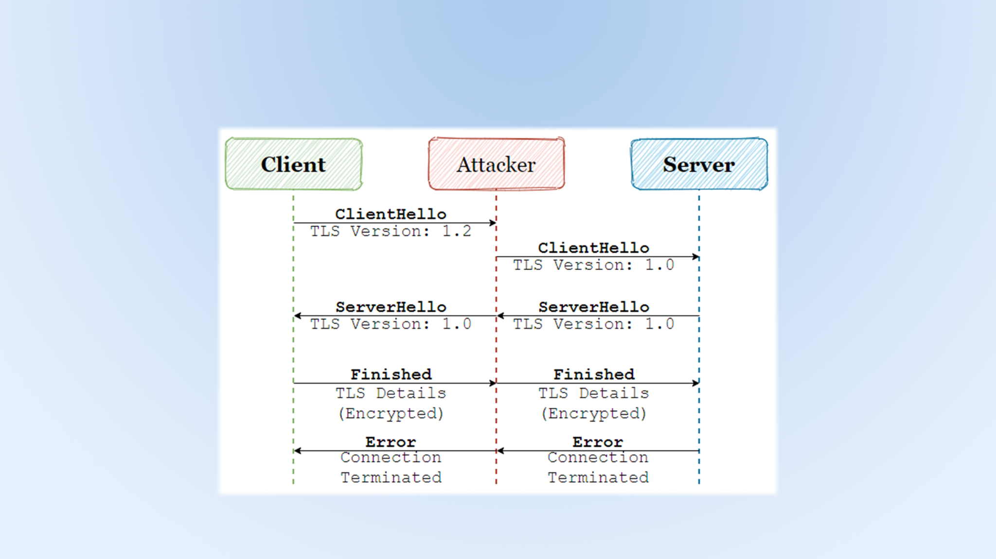
A simple attack:
defence mechanism

Slide 6
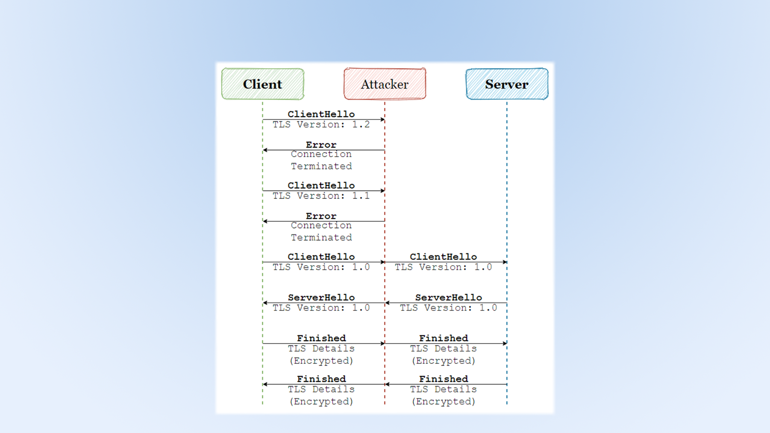
A better attack

Slide 7
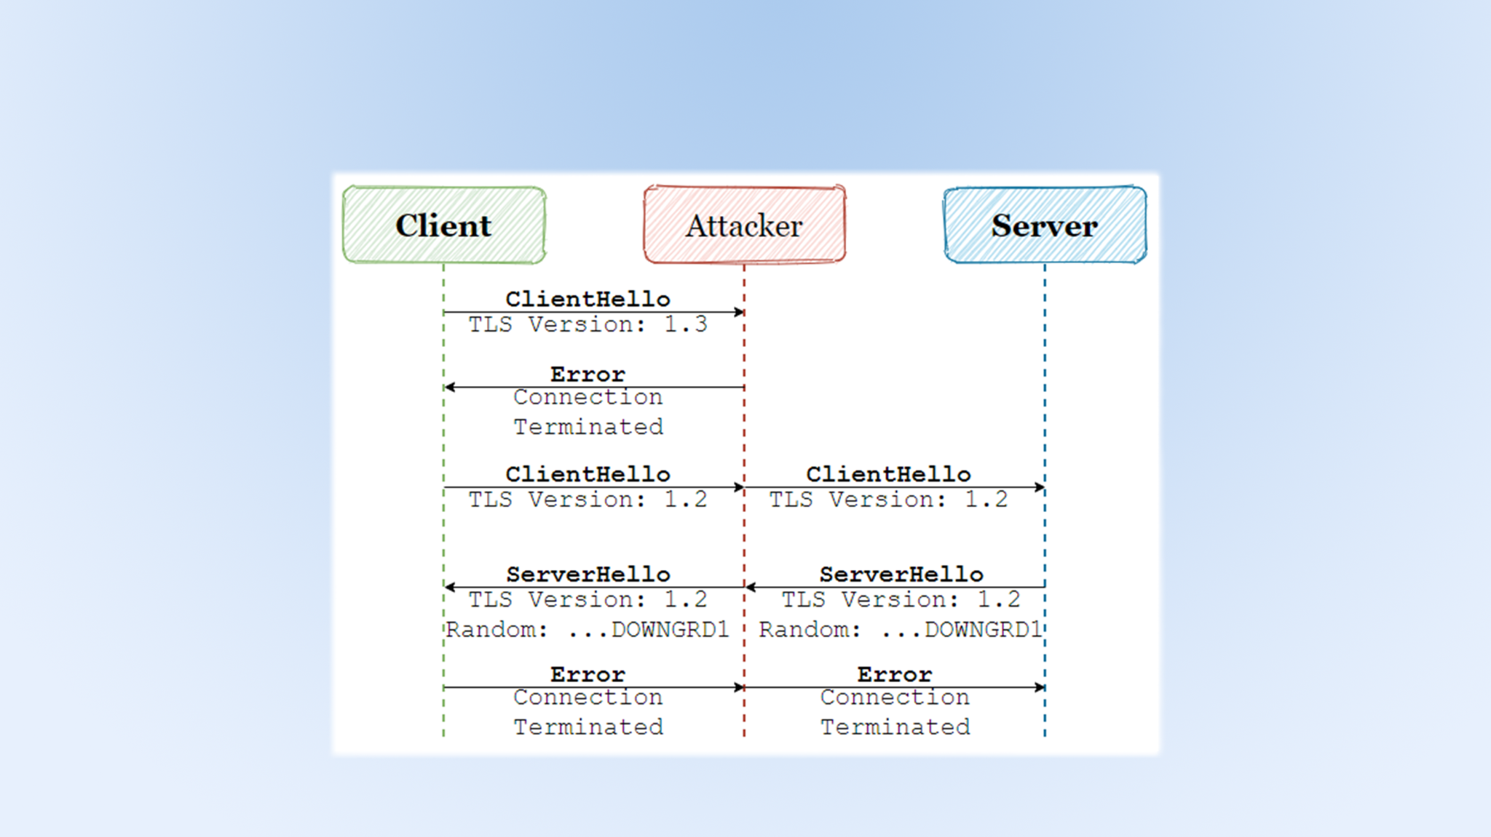
A better attack:
defence mechanism

Slide 8
References
https://tools.ietf.org/html/rfc8446
https://tools.ietf.org/html/rfc5246
https://blog.gypsyengineer.com/en/security/how-does-tls-1-3-protect-against-downgrade-attacks.html
https://www.praetorian.com/blog/man-in-the-middle-tls-ssl-protocol-downgrade-attack/

Slide 9
Thank you!

